Slide 1



Slide 2
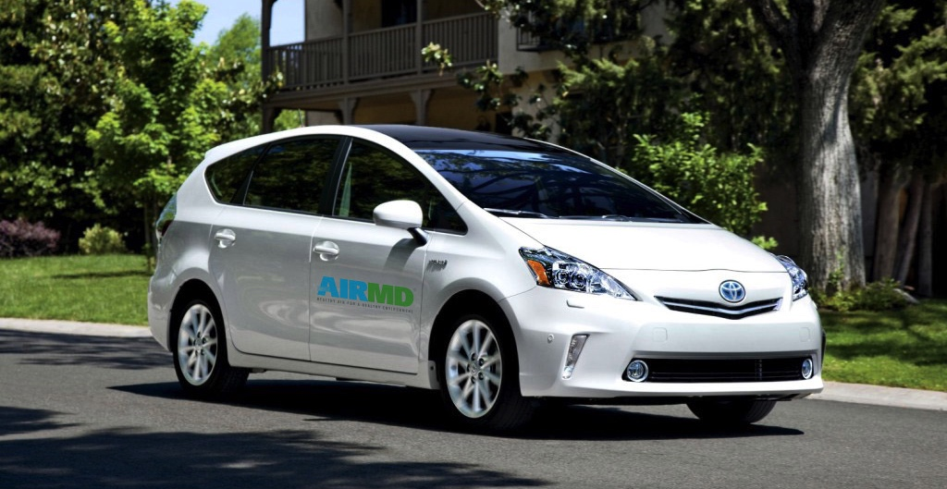
About AirMD
AirMD Inc., an environmental company specializing in indoor air quality and building assessments for indoor environments. AirMD Inc. began operations in Palm Beach County, Florida and currently serves all Florida as well as other states Founder and Scientific Director Mr. Simon Hahessy who headed operations since AirMD opened says “According to the Environmental Protection Agency, indoor air quality is a greater health hazard than outdoor air pollution with pollutants being up to 100 times higher indoors.”
AirMD’s
Philosophy
AirMD provides the highest level and most dependable indoor air quality testing and environmental services for its customers.
AirMD puts the customer first and always provides reliable, accurate results with the most responsible customer support possible.

Slide 3
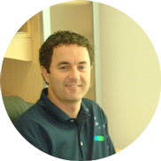
Get to Know Our Founder
Meet Simon Hahessy
“The indoor environment has always been my passion throughout my entire career. I am driven to make indoor environments safer for the people who work or live in them. AirMD LLC. was founded because of the limitations of indoor environmental services available on a national level. The AirMD franchise will establish a national environmental testing and consulting company which was missing in the marketplace.”
---- Simon Hahessy, Founder and Scientific Director
Background
Mr. Hahessy has been in the environmental industry for almost twenty years, prior to founding AirMD Inc in 2008, he served for ten years as the Vice President and Scientific Director of a nationally accredited environmental laboratory where he directed the laboratory analysis, field work, risk assessment procedures, and quality assurance compliance. His field of expertise includes industrial hygiene and environmental assessments for governmental, industrial, healthcare, educational and residential and commercial buildings. His work has been published by the “American Academy of Clinical Toxicology,” and the “European Association of Poisons Centers and Clinical Toxicologists.” Mr. Hahessy also served as an educational instructor for the IAQA certification courses including the Certified Indoor Environmental Consultant and Certified Mold Remediation curriculum.
Mr. Hahessy is a graduate of the University of Coventry, Coventry England, with focus on Environmental Science and is certified in both Pollution Assessment and Applied Biology.
SIMON HAHESSY
SCIENTIFIC DIRECTOR

Slide 4
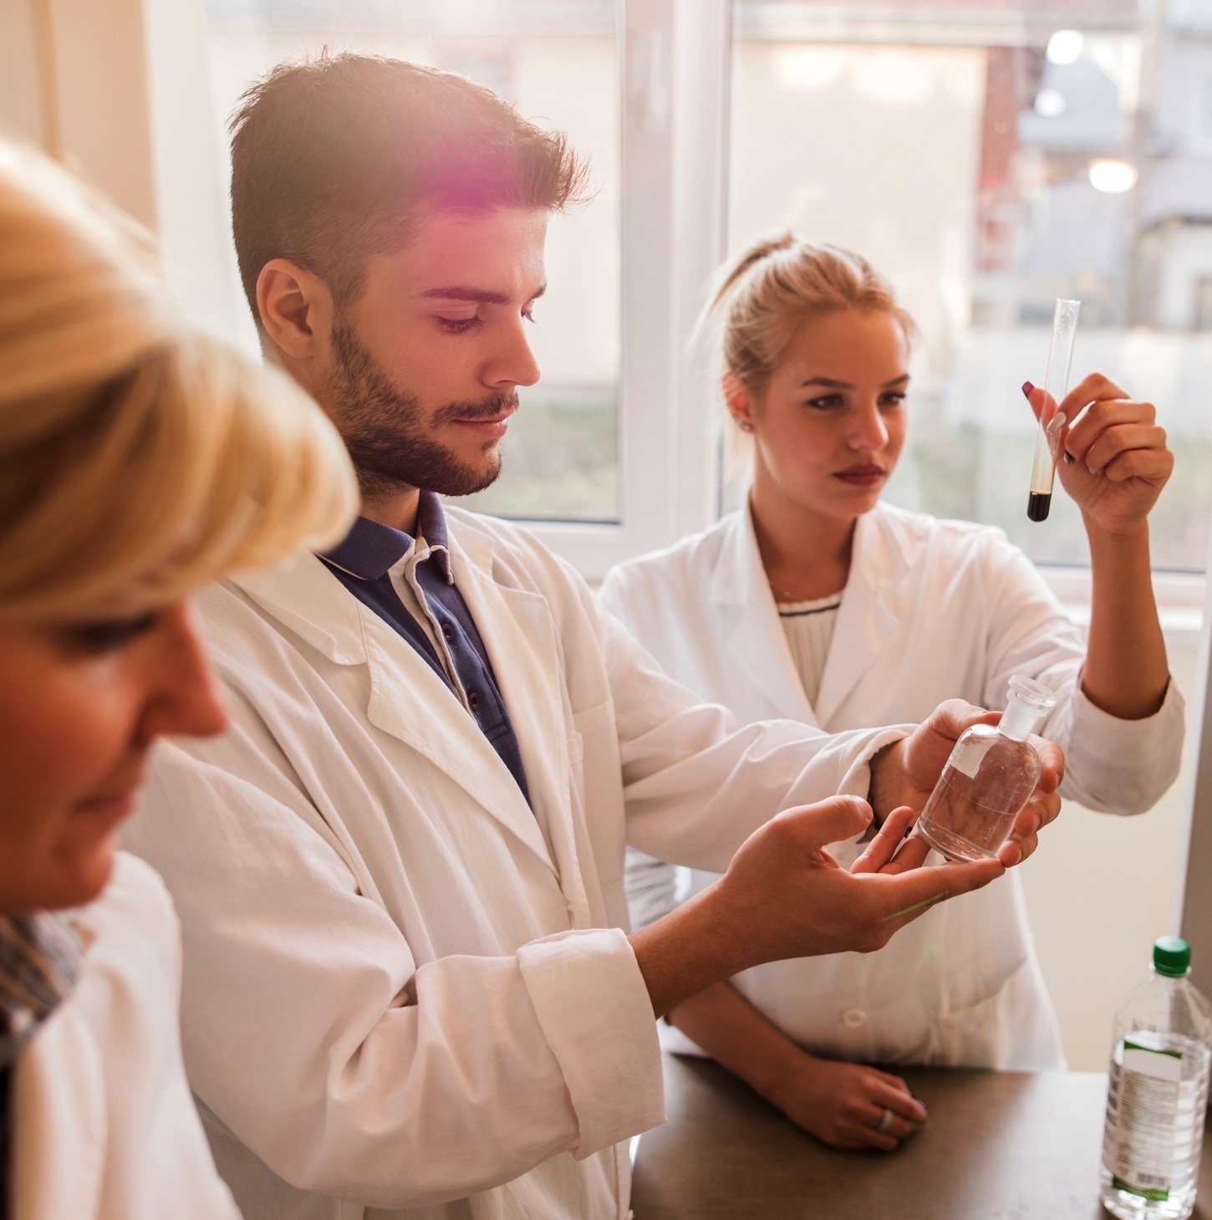
Meet the Team
Get to know the people behind AirMD
Simon Hahessy
Samantha Theaumont
Founder + Scientific Director
Managing Director
Founder and Scientific Director. A graduate of the University of Coventry with a focus on Environmental Science and certified in Pollution Assessment and Applied Biology.
Co-Founder and Managing Partner of AirMD LLC. Former Partner and President of the spa810 franchise group. Samantha is a graduate from The Ohio State University in Behavioral Sciences.
Andrew Friedman
Rachel Rupp
Legal
Project Director
Mr. Friedman has been legal counsel for the Company since inception (June, 2017). From June, 1997 to the present, Mr. Friedman has been a partner in the law firm Friedman, Rosenwasser & Goldbaum, P.A. in Boca Raton, Florida.
Rachel Rupp, Senior Project Manager of AirMD. Rachel attended the University of Central Florida with a major in forensic science and microbiology, and is certified as a CIE, EPA Lead Assessor and is a licensed Asbestos Inspector.
Lisa Talio
Operations Director
Lisa Talio has been Operations Director for AirMD for five years. Previously, she worked in the Environmental Industry heading operations for a regional IAQ consulting company.

Slide 5

What Makes AirMD The Best Environmental Testing Company?
AirMD’s field and scientific classroom training plus its certificate of approval prior to operating an AirMD franchise combined with national accounts customer service gives customers the highest level of confidence.
AirMD exceeds industry standards and guidelines and projects are completed on time and on budget.
Our Environmental Consultants test and evaluate your home or office for mold, asbestos, water intrusion, allergens, lead, bacteria, chemicals and volatile organic compounds. AirMD’s protocols and procedures require all reporting to be verified by third-party laboratory analysis.

Slide 6

The AirMD Purpose
The world outside has an environment and so does your home or office. Often these indoor environments become contaminated due to storms, natural disaster, water intrusion, bio-contaminants or chemicals, all of which can lead to health issues and lost productivity for businesses.
If you have experienced an event that may have affected the indoor environment in your home or businesses, hiring a professional environmental company must be your first step.
AirMD only utilizes AirMD certified environmentalists on its projects.
AirMD, Environmental Science for your home and office.

Slide 7

You do not Need a Scientific Background
AirMD personnel have a wide range of experience in the scientific and engineering fields. Our staff of professional scientists and engineers have backgrounds in bacteriology, mycology, aerobiology, microscopy, environmental science and toxicology and will train and certify AirMD franchisees in required disciplines for their day to day operations.
To stay ahead of the curve, our scientists and engineers receive on-going training and the required education on the latest technology, procedures, industry advancements and developments.

Slide 8

Who Makes a Good AirMD Affiliate?
Someone with an entrepreneurial spirit and a passion for making other’s lives better. If this describes you, you may be right for AirMD.
Qualified candidates should have:
A strong business acumen
Excellent customer service skills
Demonstrate the core values of AirMD and have passion to succeed
Candidates must be able to meet the AirMD financial requirements
Successfully complete the AirMD franchisee training and certification requirements

Slide 9
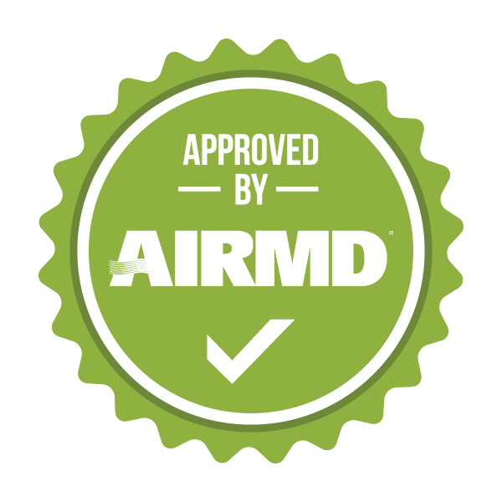
What is the AirMD Testing and Evaluation Process?
If a home or business experiences an event that affects the indoor environment hiring a professional environmental company must be the first step. This is where AirMD’s highly trained consultants will test and evaluate your home or office for contaminants. Testing and inspection services include mold, asbestos, water, allergens, lead, bacteria, chemicals and VOCs.
AirMD does not perform remediation services as this is a conflict of interest.
First, we find the source of the problem. Visible contaminants are easy to spot, but mold and other biological hazards could be hiding anywhere, just because you don’t see them doesn’t mean they are not there.
Next, we determine the extent of the problem.
We determine which issues can cause harmful health effects by performing air quality and other scientific testing.
After testing, we provide a detailed report with recommendations on how to solve the problem.
Lastly, we confirm the problem was solved.
Once remediation in your home or office has been completed, we can test again to make sure the home or office has been clear of contaminants.

Slide 10

Why is AirMD Vital to Commercial Communities?
Commercial
According to the Occupational Safety and Health Administration (OSHA) experts believe more people suffer from the effects of indoor air pollution than from outdoor air pollution.
It is estimated that IAQ problems cost the US economy as much as $168 billion per year and there have been many high profile indoor air quality litigation cases in recent years. Commercial clients are becoming increasingly aware of liability in the workplace and the need to have verified information as to workplace environment safety standards.
FACT: CDC estimated Americans spend 90% of their time indoors either at home or in a workplace environment. Providing a safe workplace is not only a regulatory requirement it is also an effective way of improving performance and reducing absenteeism leading to increased profitability.
Reduced worker productivity, increased absenteeism, occupant/employee complaints and the increase for litigation may potentially be attributed to unsatisfactory indoor environmental conditions.

Slide 11
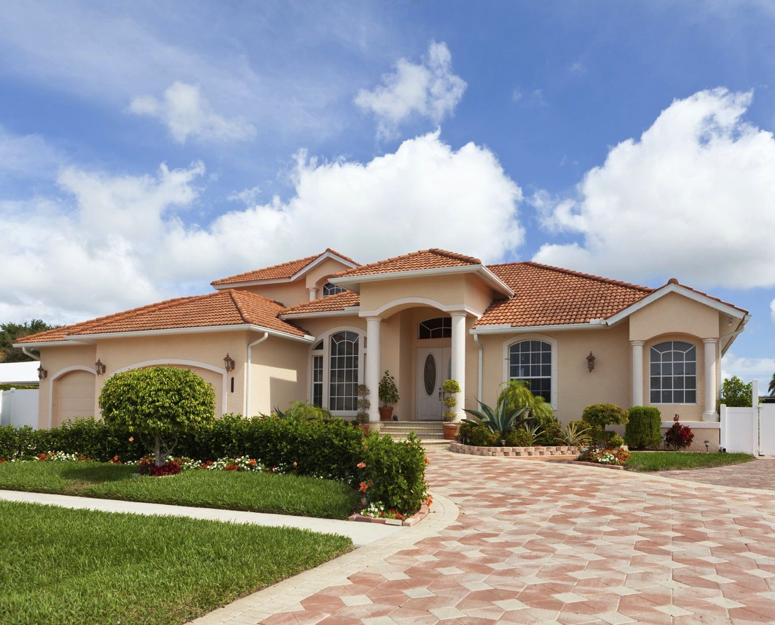
Why is AirMD Vital to Residential Communities?
Residential
Indoor environments are where people spend most of their time. Studies have shown that people spend approximately 90% of their time indoors, with the majority in their own homes. For many people, the risks to health may be greater exposure to air pollution indoors than outdoors. Most people do not know their homes can cause a threat or risk to their health, but over time, poor indoor environmental quality can play a significant role in deterioration of a resident’s health especially children and older residents. Independent testing has determined over 50% of all respiratory illness is caused by exposure in your home or work environment.
FACT: EPA stated that indoor environments may be anywhere from 2-5 times more polluted than that of the outdoor environment.
FACT: Many IEQ problems are preventable when a proactive approach is taken.

Slide 12

How Large is the Mold and Environmental Testing Industry?
The current market is estimated to be…
The market is driven by many factors including increasing environmental regulations and recent consumer awareness. The high growth potential provides new opportunities for market players.
The current environmental testing market is estimated to be $9 Billion and is projected to reach a value of USD 11.82 Billion by 2021, at a CAGR of 6.9% from 2016 to 2021. (“Environmental Testing Market” by Sample (Wastewater/Effluent, Soil, Water, Air), Contaminant (Microbiological, Organic, Heavy Metal, Residue, Solids), Technology (Conventional, Rapid), & by Region – Global Forecast to 2021”)

Slide 13
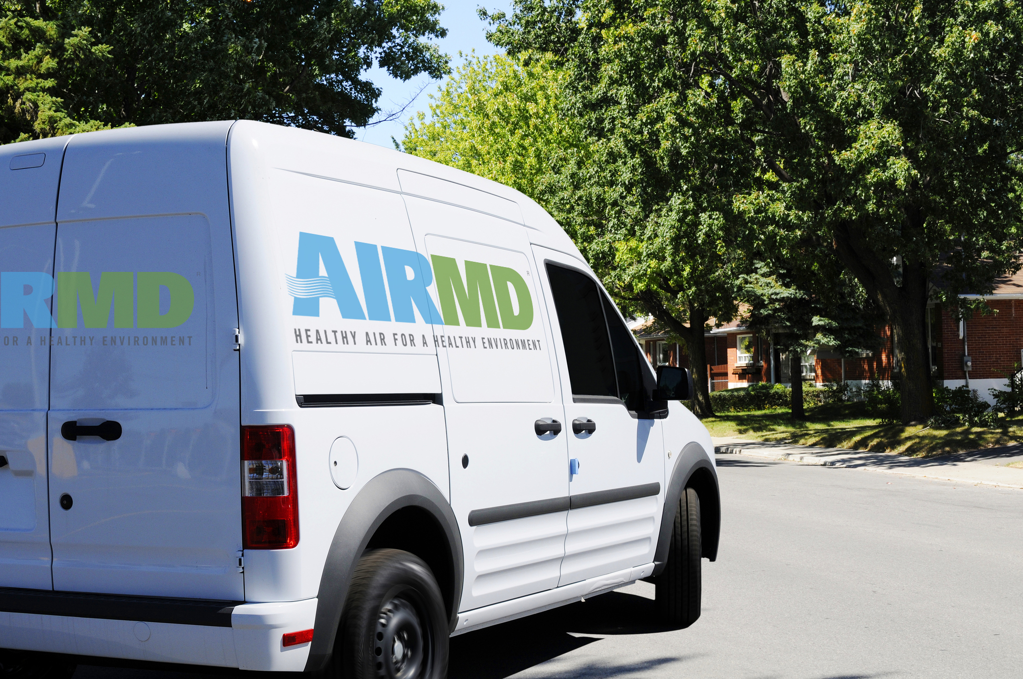
Who are the AirMD Competitors?
The IAQ industry is highly fragmented and the market consists of small local and regional players.
There are companies that provide indoor environmental testing but we are not aware of any that provides our exensive reactive and proactive services on a national level.

Slide 14



AirMD’s Unique Position in the Market
National Customer Service
AirMD Certified Environmental Consultants
Independent Laboratory Verification
On-Site Post Remediation
Testing
Reactive Testing
Proactive Testing
Member of

Slide 15

AirMD Environmental Testing Services | Commerical
Chemical
Allergen
Bacteria
Water Quality
Volatile Organic Compounds
Mold Assessments
Lead Testing
Pesticide Testing
Real Estate Inspections for Pre-Purchase, Post Construction and Pre-Occupancy
Protocol Development
Water Loss Assessments
Building Envelope Assessments
Building Science
Commercial Moisture Intrusion Investigation
Educational and Professional Facility Assessments
LEED Certification
USP 97 Pharmacopia Testing
Commercial Monitoring Program
Restoration Project

Slide 16

AirMD Environmental Testing Services | Residential
Chemical
Mold Testing
Asbestos
Allergen
Children’s Safety
Bacteria
Water Quality
Heavy Metals
Pesticide
Wellness
Real Estate Inspections for Pre-Purchase, Post Construction and Pre-Occupancy

Slide 17
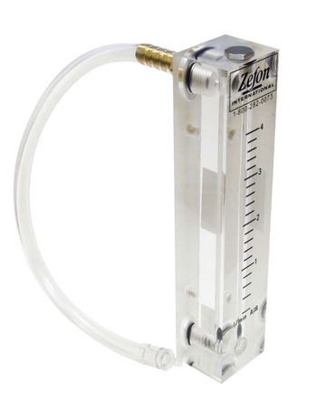
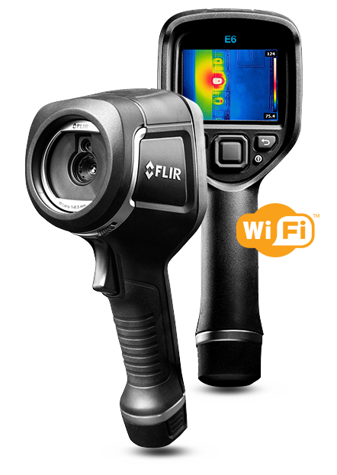
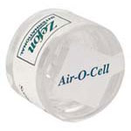
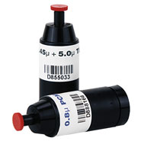
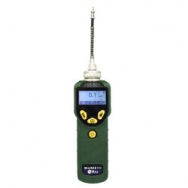
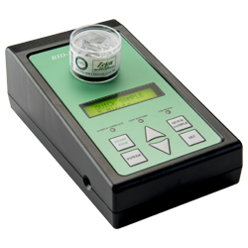
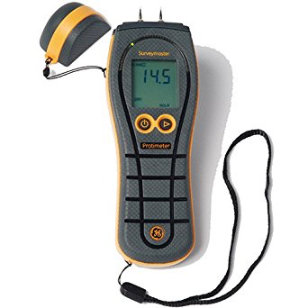
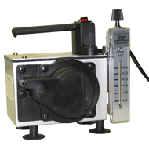
Testing Equipment
Air O Cell Sampling Cassette
Cassettes
Rotameter
FLIR E 6 Infrared Camera with MSX
Protimenter Moisture Meter
Photo Mini RAE Lite
Bio Pump Plus
Z Lite IAQ Sampling Pump

Slide 18

Support and Training
Required training for the AirMD franchise is a 12-day training program for the Franchisee at the AirMD Headquarters in Boca Raton, FL.
Training includes classroom instruction in collection and sampling of indoor environmental contaminants, field reporting, sales and marketing principles, customer service, scheduling software and the overall operations of the franchised business.
Ongoing support is available to the franchisee for sales and marketing and continuing education sessions.

Slide 19

Marketing
It is recommended to spend a minimum of $400 per month on local advertising and marketing, primarily SEO, social media, and networking to groups in key strategic industries.
Success is directly related to the amount of time devoted to marketing and advertising the business.

Slide 20


Contact Us
Have questions? Reach out to us today
AirMD, LLC.
7700 Congress Ave
Suite 1119
Boca Raton, FL 33487

Slide 21


